Slide 1
Community Loan Scheme Database Project Code First Girls Project Presentation
Isobel Olney

Slide 2
Overview Of Database Purpose
Where I live, I have seen several community loan schemes startup.
These schemes allow people who face financial difficulties the ability to hire everyday items that they would otherwise not be able to utilise. For example - a lawnmower or pressure washer.
I thought it would be an interesting project to replicate this kind of loan scheme.

Slide 3
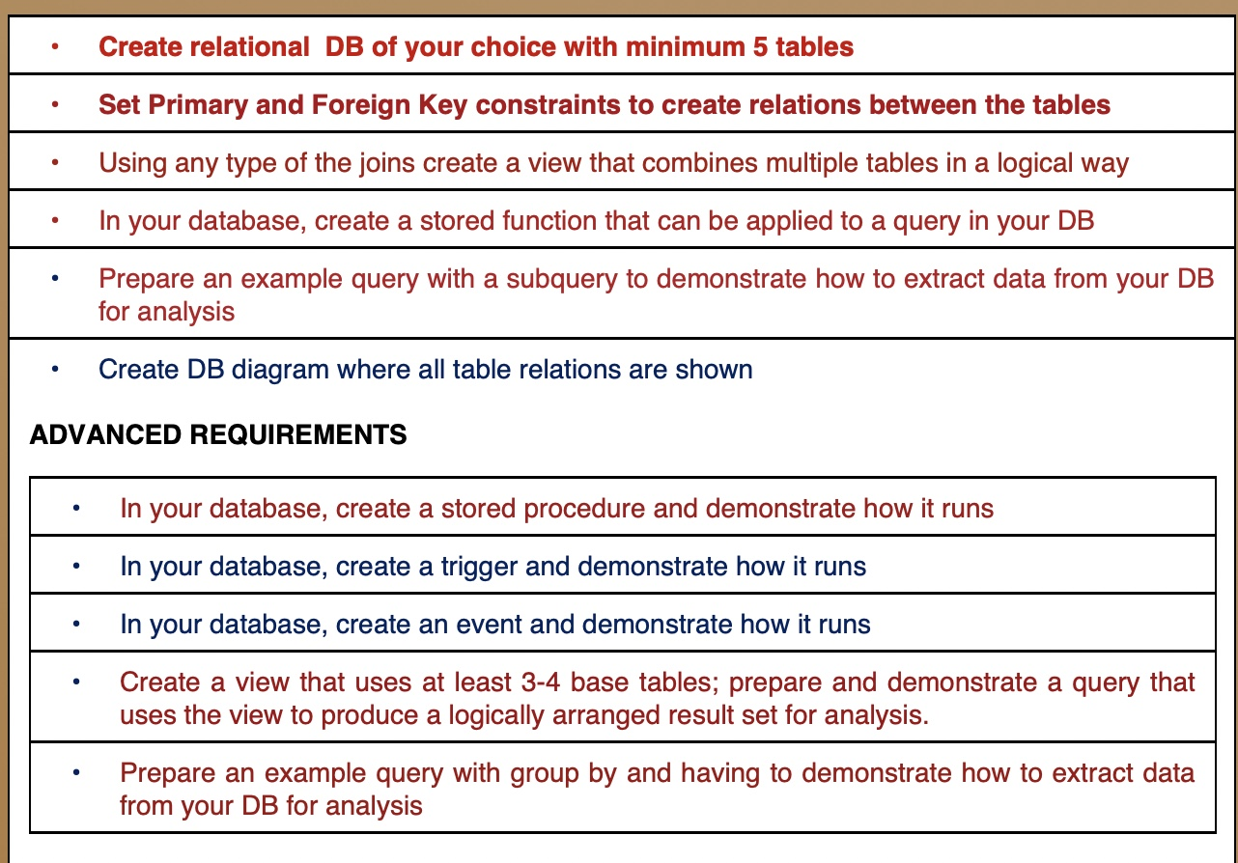
Required Project Activities
I have completed the six fundamental activities and from the advanced requirements I have created:
a sample stored procedure
a sample view that uses three base tables
an example query that uses GROUP BY

Slide 4
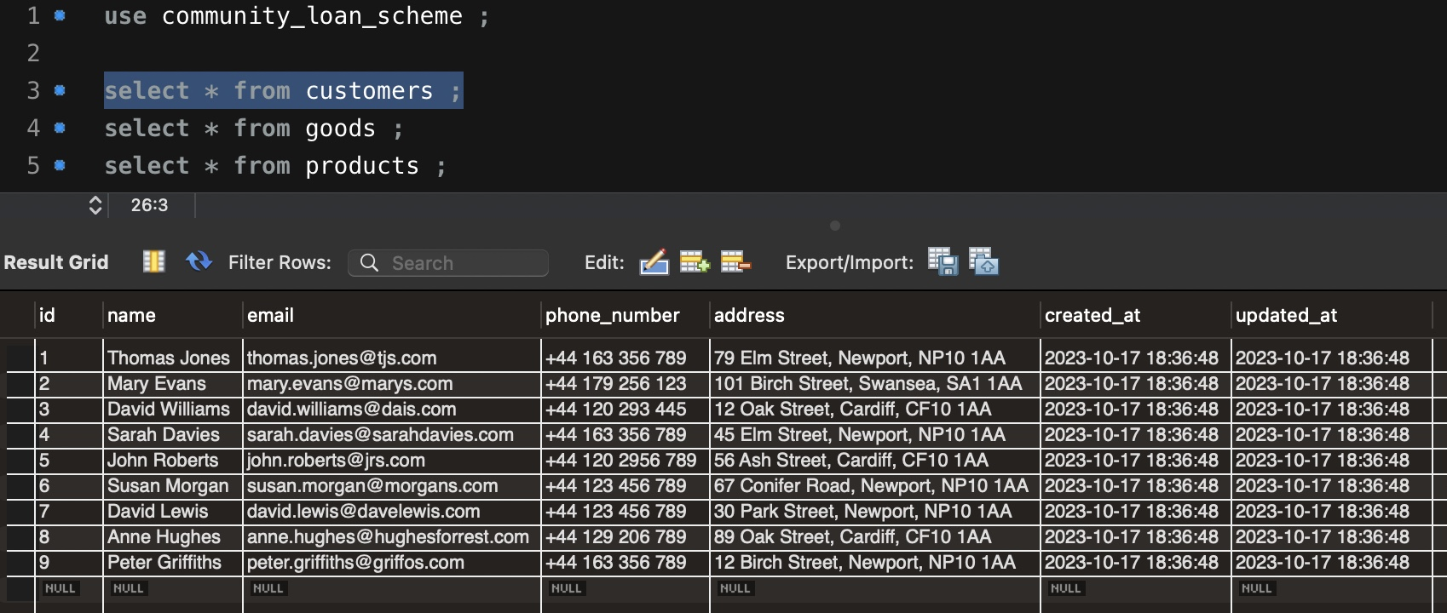
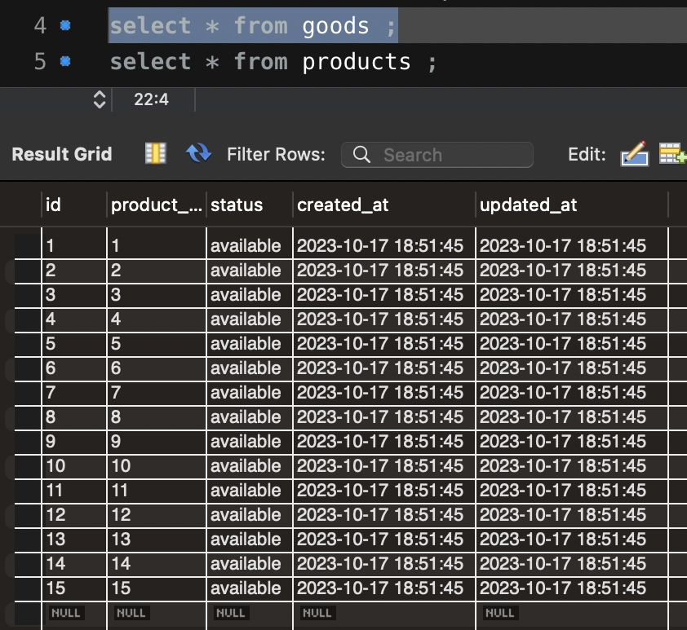
Database Table Schema and Sample Data

Slide 5
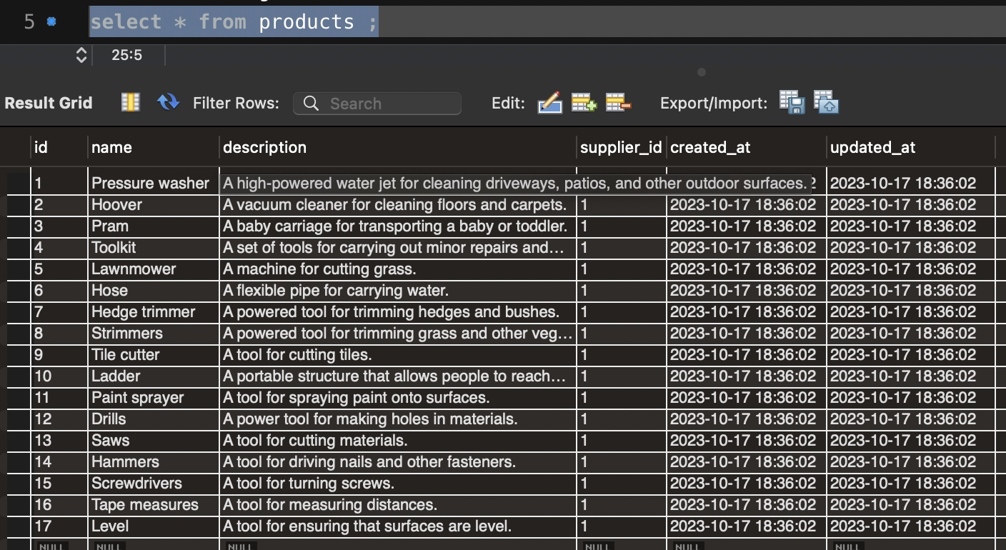
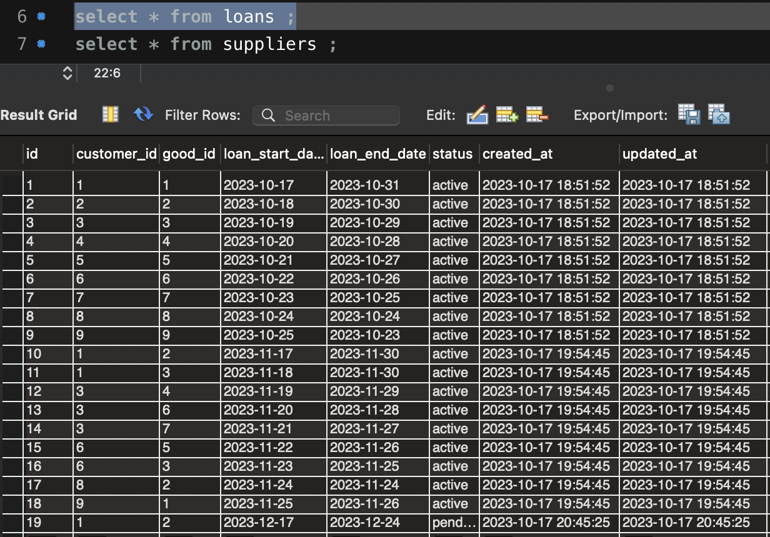
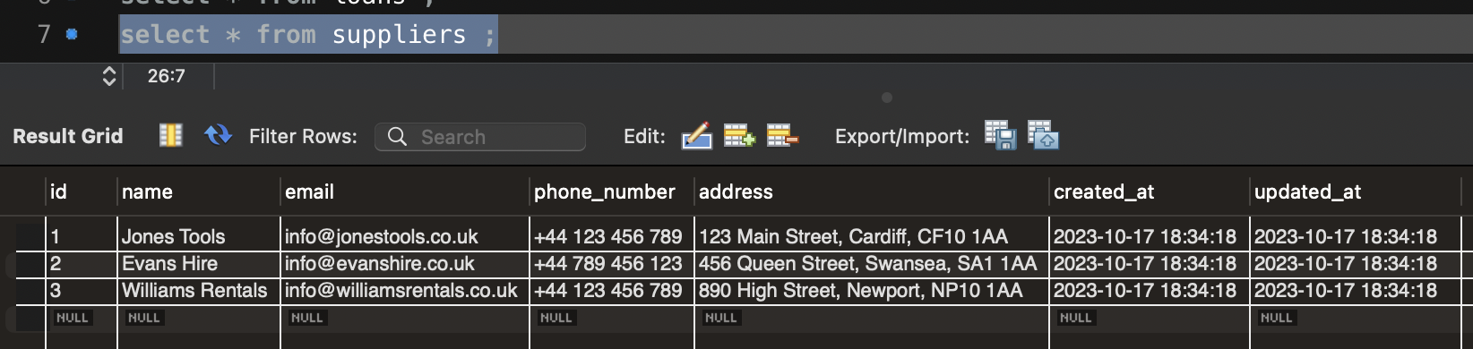
Database Table Schema and Sample Data

Slide 6
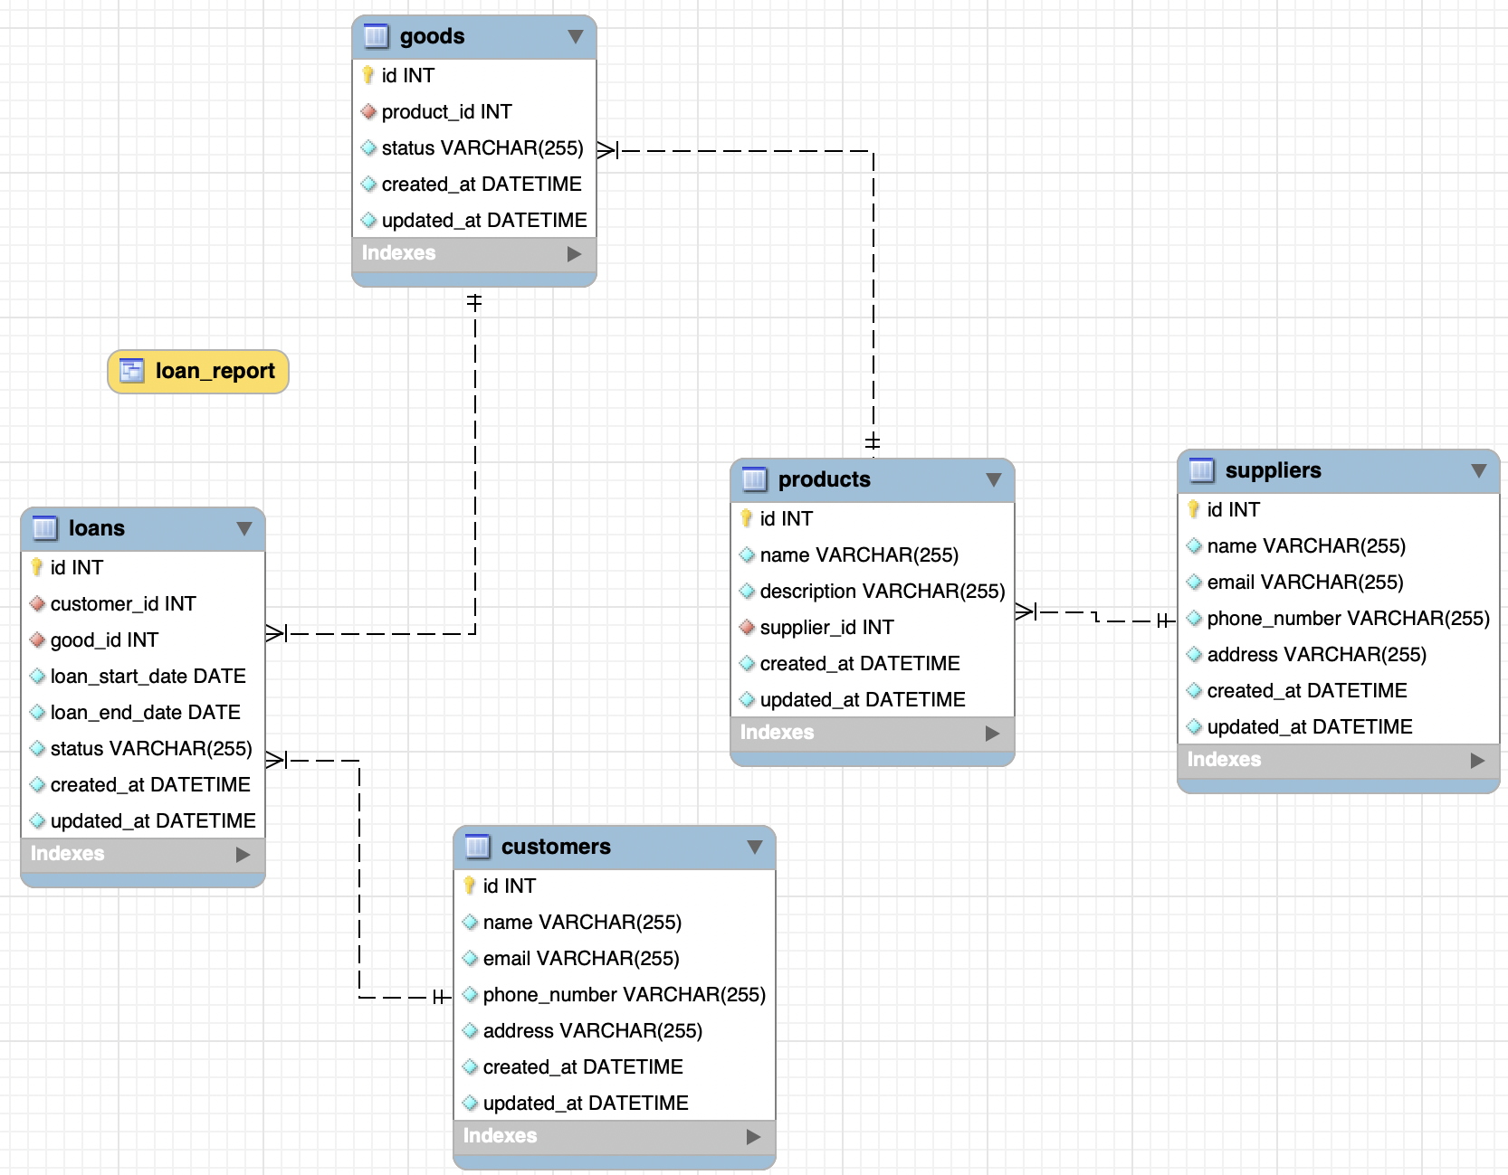
Schema Relational Diagram

Slide 7
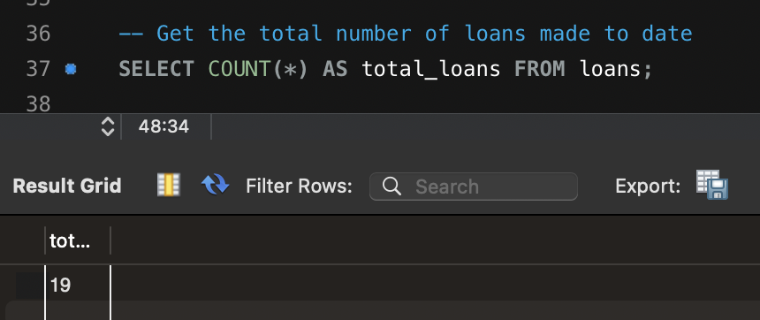
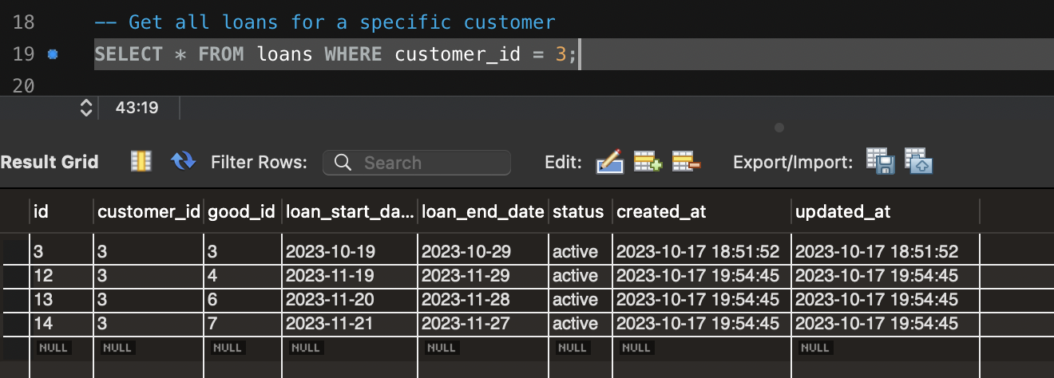
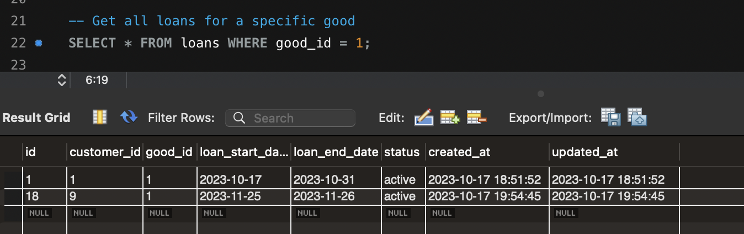
Some example queries

Slide 8
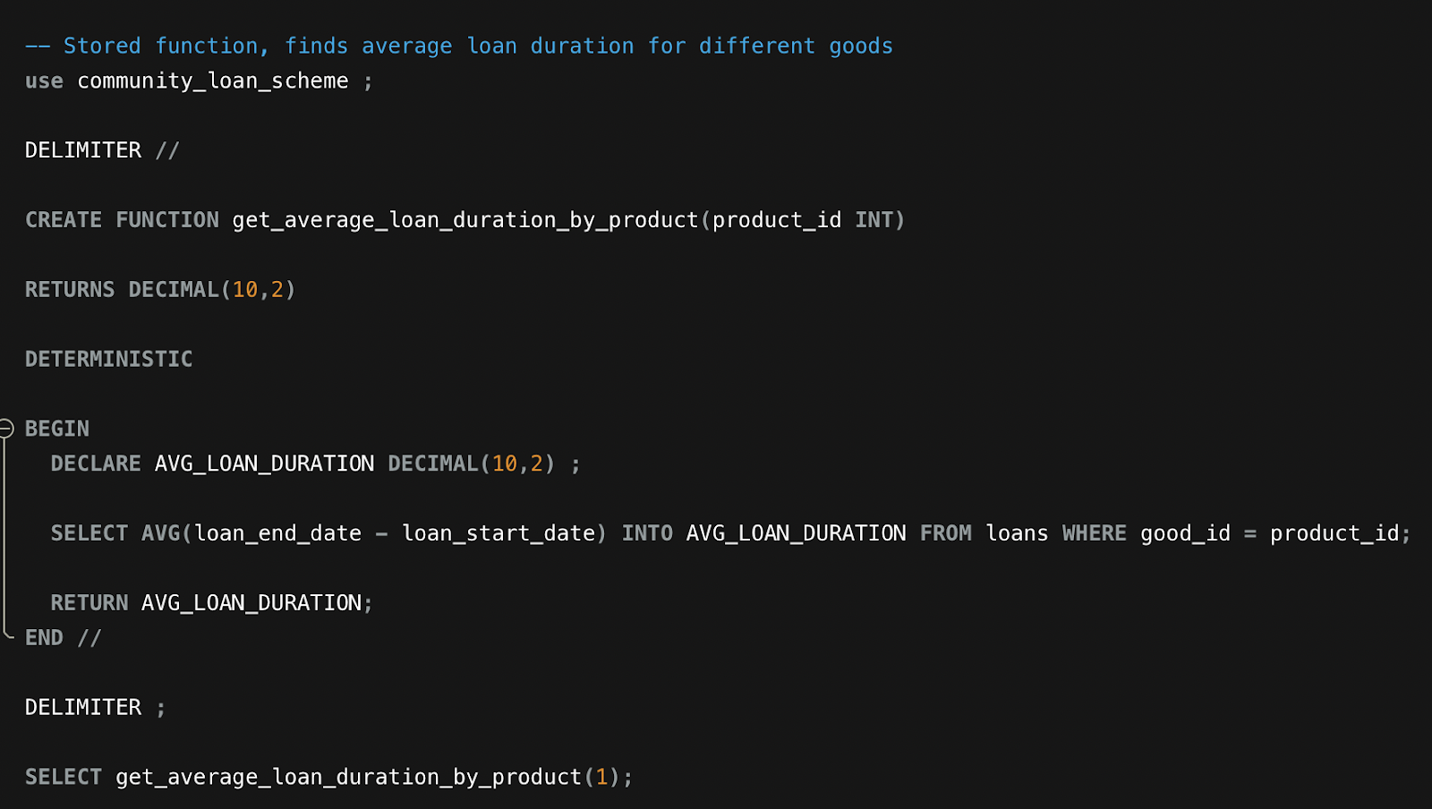
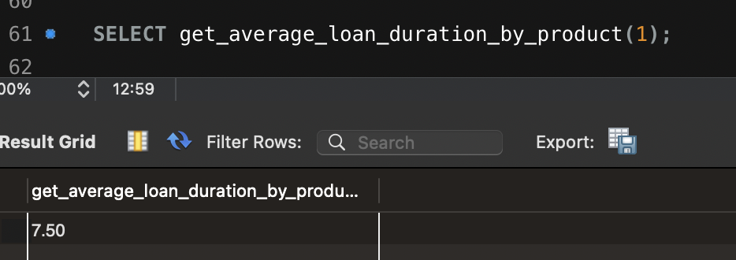
Create a Stored Function

Slide 9
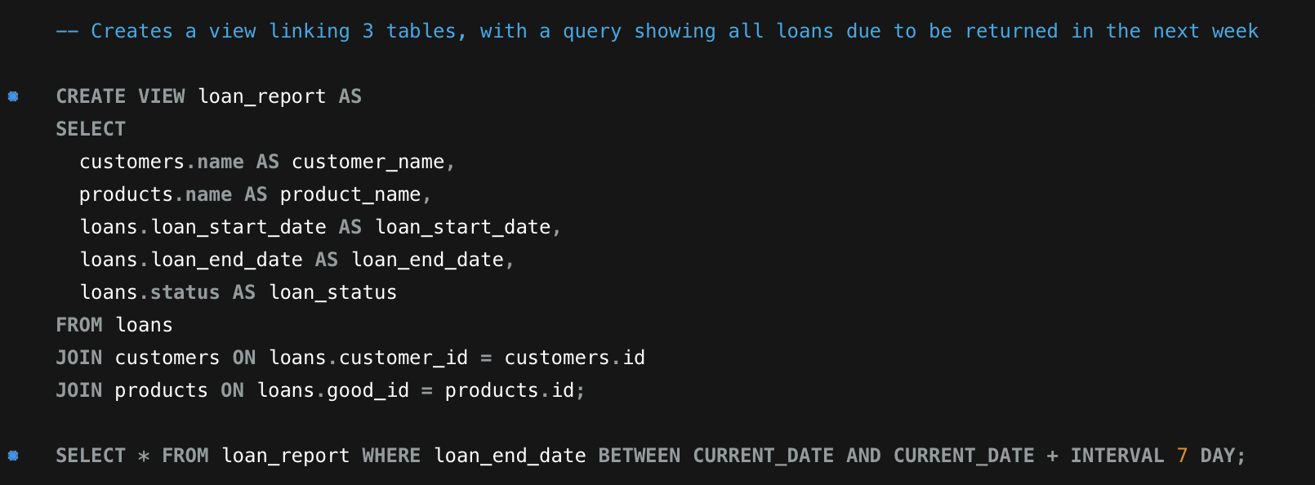
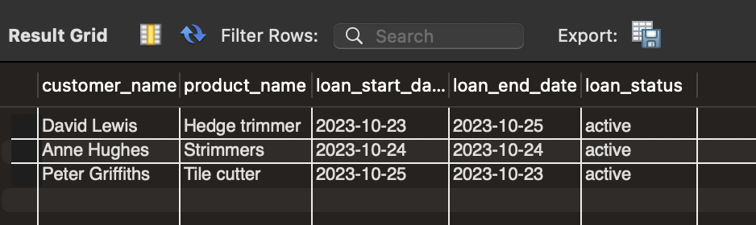
Create A Database View

Slide 10
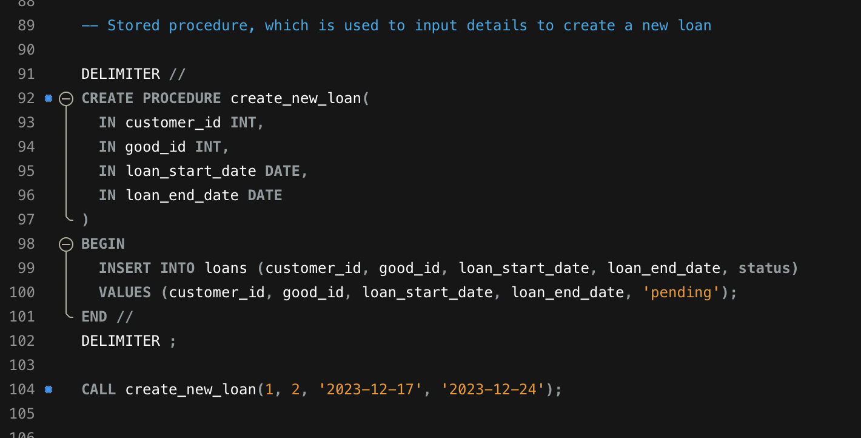
Stored Procedure

Slide 11
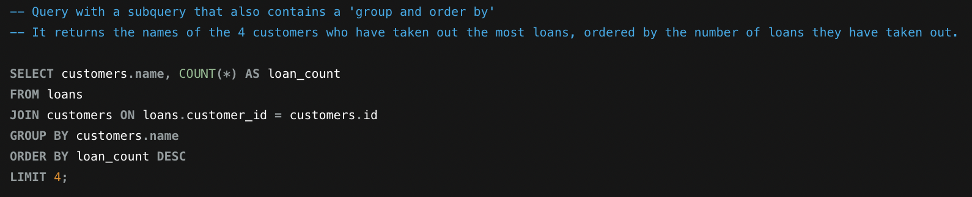
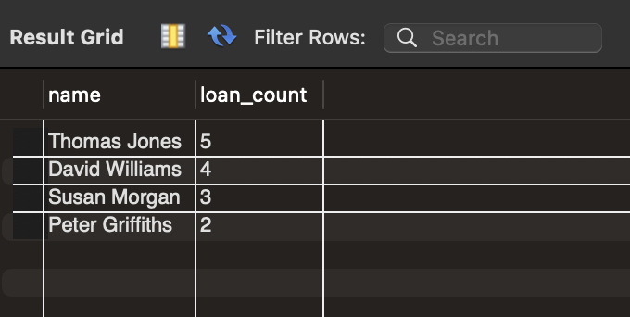
Subquery Using GROUP BY and ORDER BY

